Slide 1

Medical Insurance Cost Detection System Using Machine Learning Techniques
Department of Computer Science and Engineering
National Institute of Technology, Hamirpur
Presented By :
Presented To :
Kinshuk Sharely
20dcs024
Dr. Kamlesh Dutta
Notes:
ID=d924773e-9a16-4d6d-9803-8cb819e99682 Recipe=text_billboard Type=TextOnly Variant=0 FamilyID=AccentBoxWalbaum_Zero

Slide 2

Content
Introduction
Motivation
Objective
Datasets
Machine Learning Techniques
Model Outputs
Result Comparison
Conclusion

Slide 3


Introduction
Insurance is a policy that helps to cover up all loss or decrease loss in terms of expenses incurred by various risks
That's why it becomes important for insurance companies to be sufficiently precise to measure the amount covered by this specific policy and the insurance charges which must be paid for it.
A health insurance company can only make money if it collects more than it spends on the medical care of its beneficiaries.
However, it's hard to predict how much medical care will cost
Thus, we make use of Machine learning Techniques to ease the work of insurance companies

Slide 4
Motivation
ML systems can enhance the accuracy of medical insurance claims processing by quickly identifying fraudulent claims and errors, reducing financial losses for insurance companies.
Detecting and preventing fraudulent or incorrect claims can lead to significant cost savings for insurance providers.
Models can continuously learn and adapt to new fraud patterns, making it more challenging for fraudsters to deceive the system and discouraging fraudulent behaviour.
Faster, more accurate claims processing can lead to a better experience for policyholders, enhancing customer satisfaction and retention.

Slide 5
Objective
Developing a Medical Insurance Cost detection system using Machine Learning techniques like Linear regression, Decision tree, Random forest and gradient boost to predict insurance cost based on people’s data and compare the results of these techniques to determine the most effective and efficient approach.

Slide 6
Datasets
S.No. | Data Set | Link
1. | Medical Insurance Price Dataset | https://www.kaggle.com/datasets/harishkumardatalab/medical-insurance-price-prediction
2. | Medical Insurance Premium Dataset | https://www.kaggle.com/datasets/tejashvi14/medical-insurance-premium-prediction
3. | Insurance Dataset | https://www.kaggle.com/datasets/Datagod/insurance-dataset

Slide 7

DATA PREPROCESSING

Slide 8
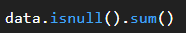
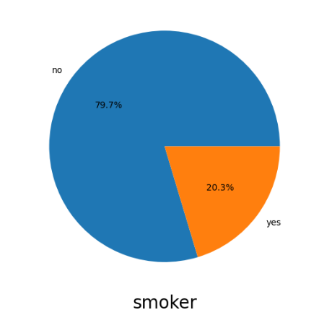
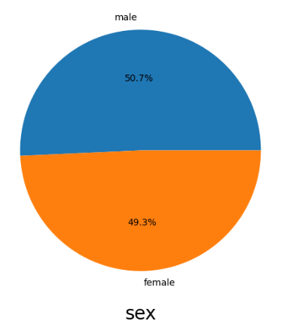
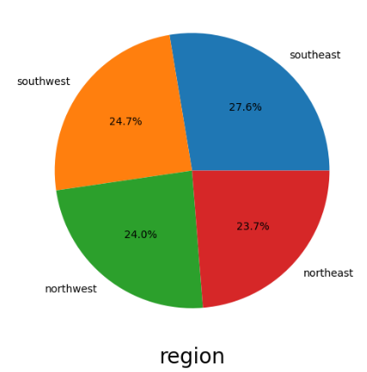
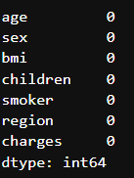
A) Checking Null Values
Dataset - 01
B) Checking Imbalanced Data
All the data was balanced except “Smoker” Feature
(Corrected using Stratified Shuffle split)

Slide 9
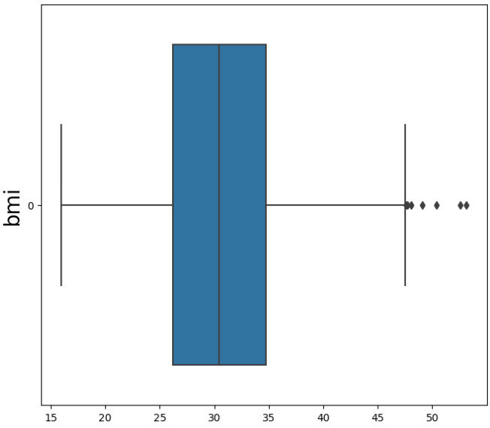
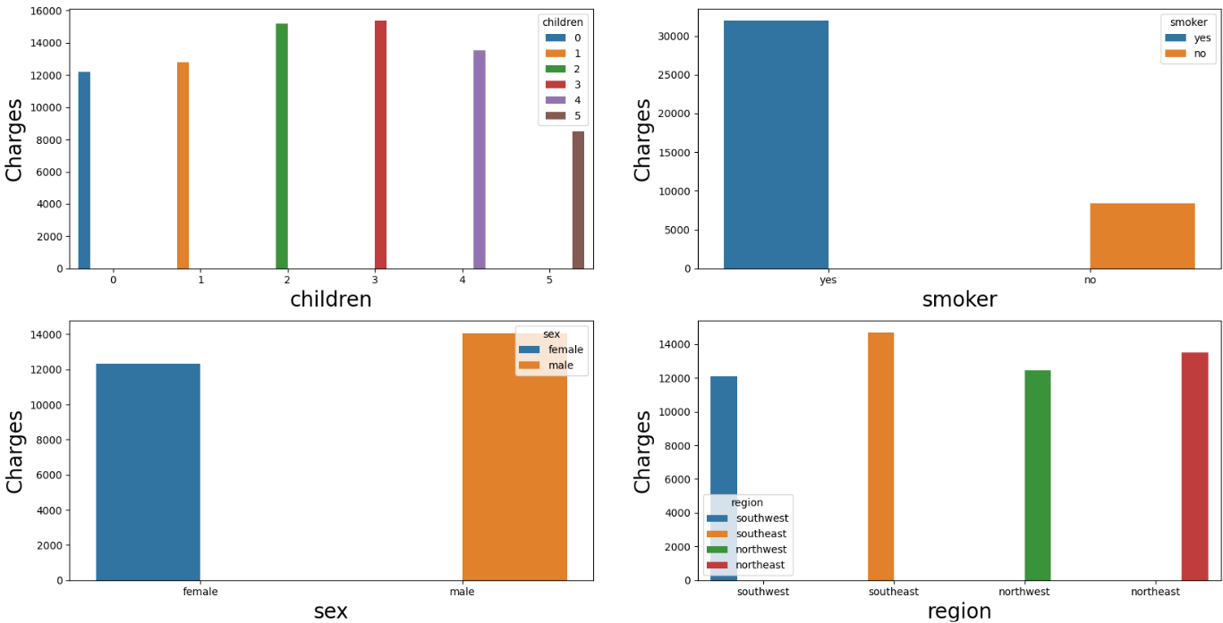
C) Finding Outliers
Dataset - 01
D) Analyzing
Some Outliers were present in the BMI feature
As there were very less values thus were discarded
Premium charged from the smokers is very high as compared to the non-smokers.
We cannot see much difference in other feature bars.

Slide 10
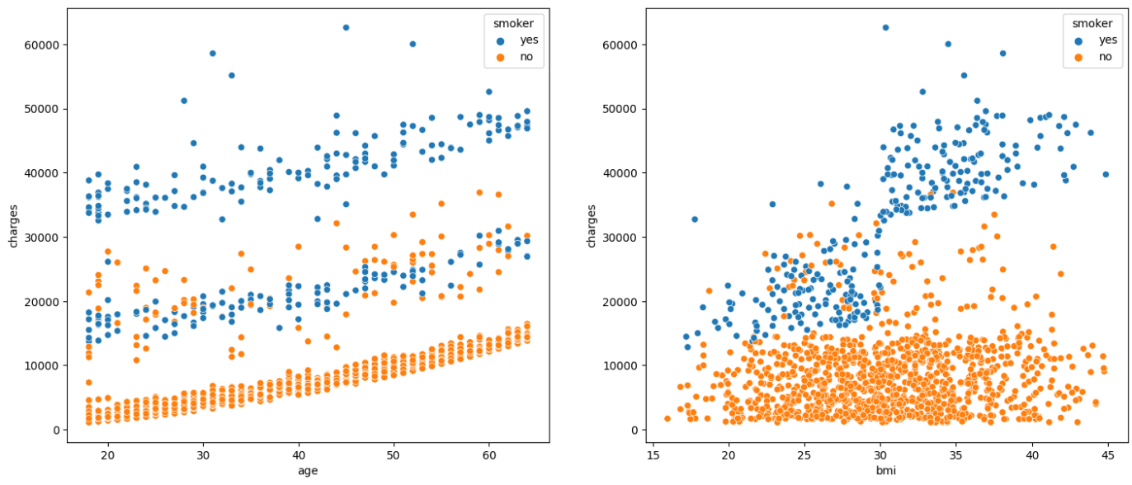
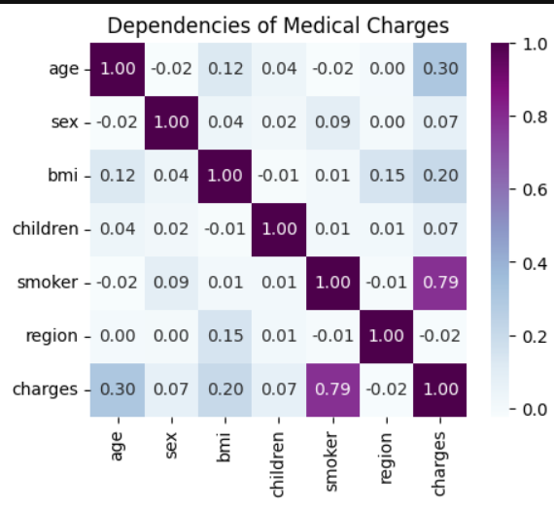
E) Plotting
Dataset - 01
F) Features on which
Charges Depend

Slide 11
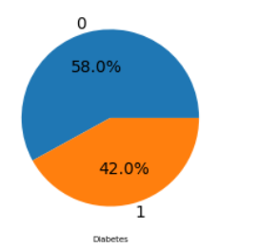
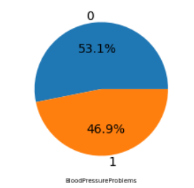
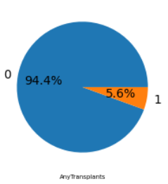
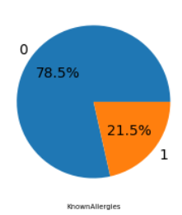
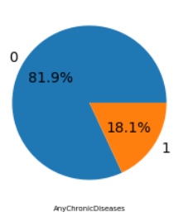
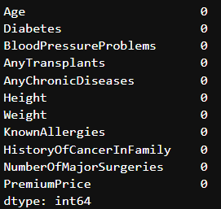
A) Checking Null Values
Dataset - 02
B) Checking Imbalanced Data
Above we can see the imbalance in the percentages of Transplants, chronic Disease and Known Allergies
(Corrected using Stratified Shuffle split)

Slide 12
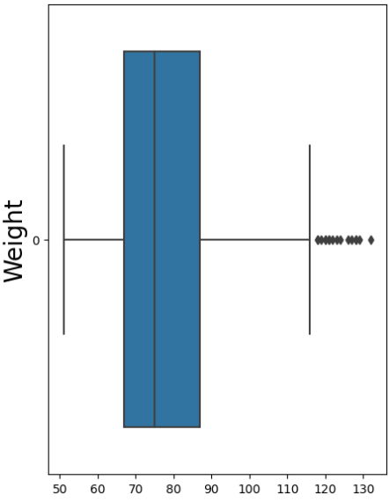
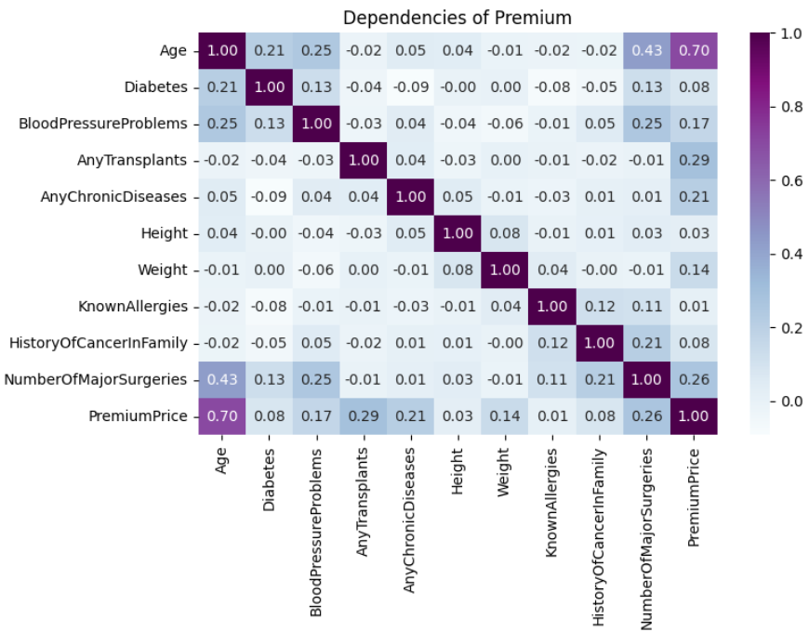
C) Finding Outliers
Dataset - 02
D) Features on which
Premium Depends
Premium is highly dependent on :
Age
Blood Pressure Problems
Any Transplants
Any Chronic Disease
Weight
No. Of major Surgeries
Some Outliers were present in the WEIGHT feature
As there were very less values thus were discarded

Slide 13
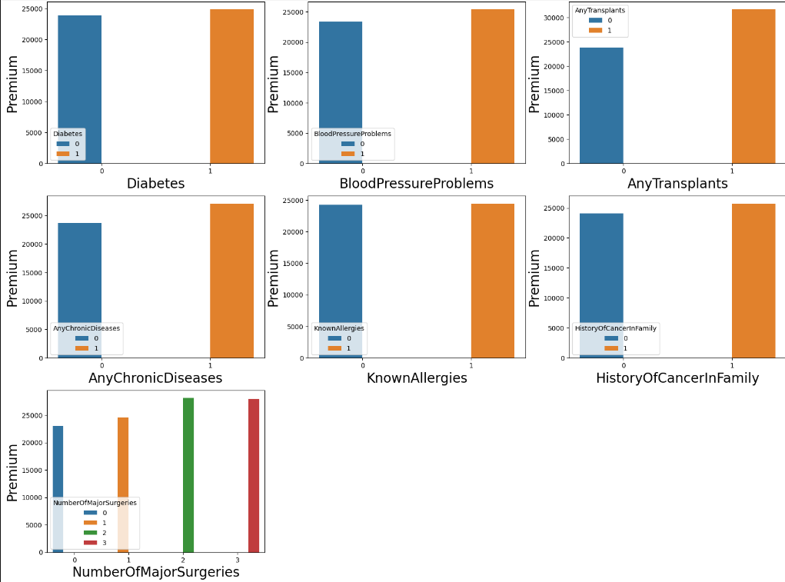
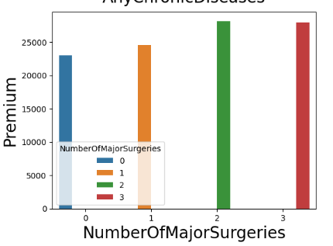
Dataset – 02
D) Analyzing (features , Premium)

Slide 14
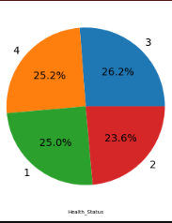
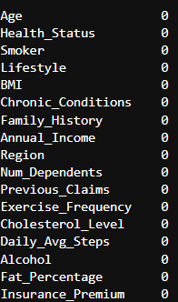
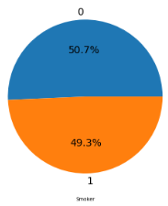
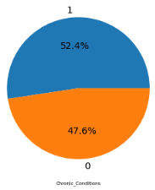
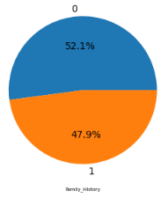
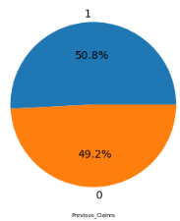
A) Checking Null Values
Dataset - 03
B) Checking Imbalanced Data
We can see that the given features are fairly balanced

Slide 15
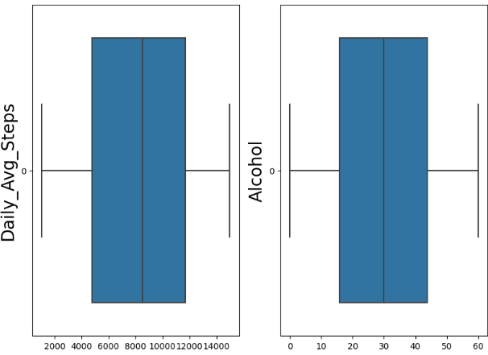
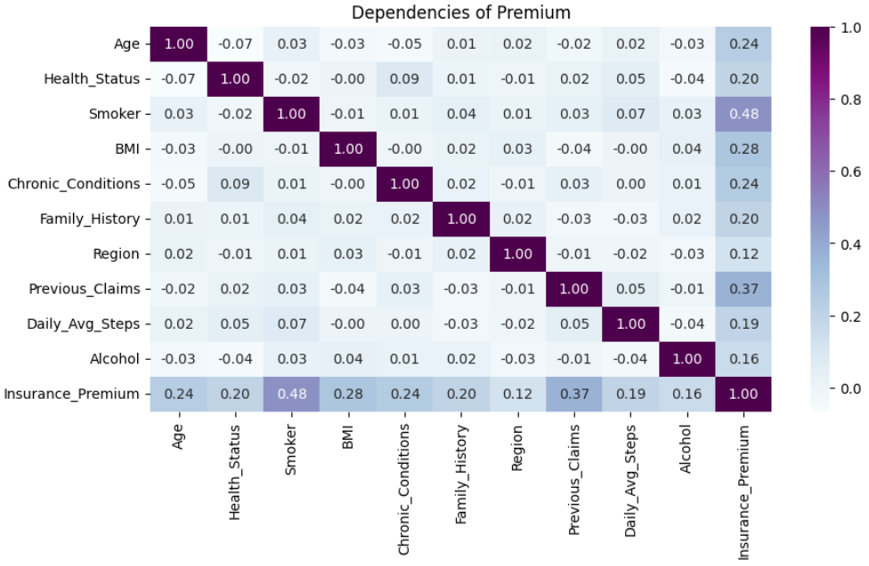
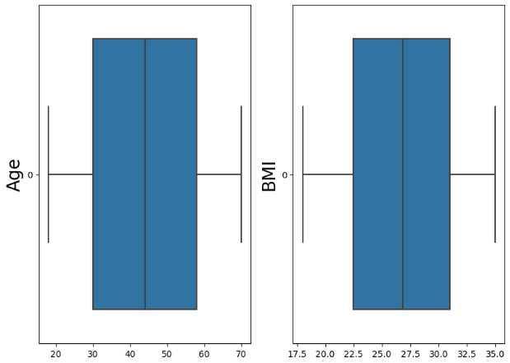
C) Finding Outliers
Dataset - 03
D) Features on which
Premium Depends
Premium is highly dependent on :
Age
Health Status
Smoker
Chronic Conditions
BMI
Family History
Previous Claims
Daily Average Steps
Alcohol Consumption

Slide 16
Machine Learning Techniques

Slide 17
Models
Linear Regression
It is a Regression Algorithm.
It is a supervised Machine Learning model in which the model finds the best fit linear line between the independent and dependent variable
Decision Tree
It can be utilized for both classification and regression tasks
A decision tree is a tree-like structure that represents a series of decisions and their possible consequences
Random Forest
It is also a classic example of a bagging approach as we use different subsets of data in each model to make predictions
It combines the output of multiple decision trees to reach a single result
Gradient Boost
Type: Supervised Learning, Regression (Ensemble)
Applicability: Predicting numerical values using gradient boosting.

Slide 18
Metrics
Mean Absolute Error
It is a measure of the average absolute differences between the observed and predicted values in a dataset, providing a simple and straightforward assessment of prediction accuracy.
Mean Absolute Percentage Score
It is a metric used to evaluate the accuracy of forecasts or predictions by measuring the average percentage difference between the actual and predicted value.
R2 Score
It is a statistical measure used to assess the goodness of fit of a regression model.
Adjusted R2 Score
It is a modified version of the R-squared (R2) score in regression analysis
Adjusted R2 adjusts R2 for model complexity, and a higher value indicates a better balance between model fit and simplicity.

Slide 19
Model Outputs

Slide 20
Dataset - 01
MODELs | MAE (Mean Absolute Error) |  | MAPE (Mean absolute percentage error) |  | R2 Score |  | Adjusted R2 Score
 | Train | Test | Train | Test | Train | Test | Train | Test
Linear Regression | 4205.07 | 4138.88 | 0.439 | 0.4252 | 0.745 | 0.7545 | 0.741 | 0.75
Decision Tree | 13.68 | 918.94 | 0.004 | 0.0836 | 0.999 | 0.915 | 0.99 | 0.91
Random Forest | 569.29 | 1429.57 | 0.074 | 0.153 | 0.989 | 0.927 | 0.98 | 0.92
Gradient Boost | 2051.28 | 2214.9 | 0.259 | 0.258 | 0.899 | 0.878 | 0.89 | 0.87

Slide 21
Dataset - 02
MODELs | MAE (Mean Absolute Error) |  | MAPE (Mean absolute percentage error) |  | R2 Score |  | Adjusted R2 Score
 | Train | Test | Train | Test | Train | Test | Train | Test
Linear Regression | 2672.92 | 2782.35 | 0.114 | 0.119 | 0.627 | 0.631 | 0.621 | 0.626
Decision Tree | 12.36 | 1275 | 0.0004 | 0.049 | 0.998 | 0.663 | 0.99 | 0.658
Random Forest | 478.27 | 1415.5 | 0.019 | 0.058 | 0.965 | 0.773 | 0.96 | 0.769
Gradient Boost | 1156.3 | 1585.01 | 0.046 | 0.062 | 0.878 | 0.79 | 0.87 | 0.788

Slide 22
Dataset - 03
MODELs | MAE (Mean Absolute Error) |  | MAPE (Mean absolute percentage error) |  | R2 Score |  | Adjusted R2 Score
 | Train | Test | Train | Test | Train | Test | Train | Test
Linear Regression | 265.4 | 262.01 | 0.081 | 0.081 | 0.685 | 0.670 | 0.6804 | 0.666
Decision Tree | 0.0 | 414.4 | 0.0 | 0.128 | 1.0 | 0.106 | 1.0 | 0.092
Random Forest | 111.97 | 291.1 | 0.035 | 0.091 | 0.94 | 0.725 | 0.939 | 0.709
Gradient Boost | 189.04 | 278.34 | 0.058 | 0.08 | 0.83 | 0.61 | 0.827 | 0.606

Slide 23
Dataset Comparison
MODELs | Dataset-1 (Accuracy) |  | Dataset-2 (Accuracy) |  | Dataset-3 (Accuracy)
 | Train | Test | Train | Test | Train | Test
Linear Regression | 0.745 | 0.7545 | 0.627 | 0.631 | 0.685 | 0.670
Decision Tree | 0.999 | 0.915 | 0.998 | 0.663 | 1.0 | 0.106
Random Forest | 0.989 | 0.927 | 0.965 | 0.773 | 0.94 | 0.565
Gradient Boost | 0.899 | 0.878 | 0.878 | 0.79 | 0.83 | 0.61

Slide 24



Conclusion
The research uses various machine learning regression models to forecast charges of health insurance based on specific attributes and various Datasets.
From the Comparison table we can conclude that the metrics in Dataset 2 were better but the overall accuracy score was best for Dataset 1
Also Random forest was the best models providing an accuracy of over 92% on dataset1 , 77% dataset 2 and 72% on dataset 3

Slide 25




Thank you

